Slide 1
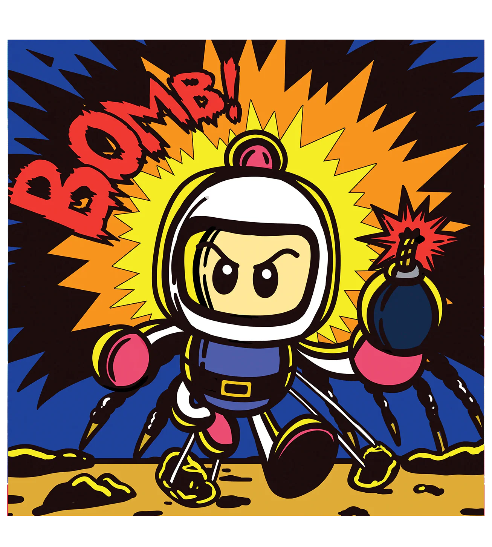

Retro Game Clone
Aaren Sherwin – ASSR1

Slide 2
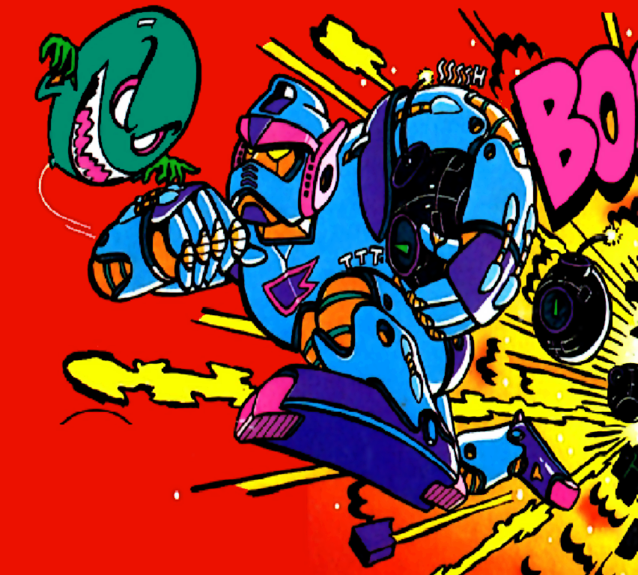
Aim of the project
The aim of the project is to bring an old game into the modern world. Fully re-implementing the original game might not be feasible in the time of the project. The new clone should stay close to key features of original. In addition, a modern twist should be added. This twist could include multiplayer options, online high scores, toggles between classic and modern graphics, save games, level editors.

Slide 3
Essential Requirements
Single-Player Controls & Bomb Placement: One player can move on the grid and place bombs that detonate after a timer.
Core Explosion & Collision Logic: Explosions occur in a cross-shaped pattern, are blocked by hard walls, destroy soft walls, and eliminate enemies and the player.
Level Progression: After all enemies are defeated, a hidden exit is revealed. Entering it loads the next sequential level.
Enemy AI: At least one type of enemy populates the levels with basic movement patterns.

Slide 4
Essential Requirements (cont.)
Power-up System: Classic power-ups (e.g., extra bombs, increased explosion range) are hidden within soft walls.
Save Game Feature: The game can save the player's state (current level, lives, score, power-up inventory) to a file and load it from the main menu to continue.
Game Menus: A functional main menu with options for "New Game" and "Load Game".
Level Timer System: Each level has a time limit. If the timer runs out, the player loses a life and the level restarts.

Slide 5
Desirable Requirements
Multiple Enemy Types: Introduce the full roster of original enemies, each with its own distinct AI behaviour and movement speed.
World Map / Level Select: A visual map screen that shows the player's progress through the game's worlds and allows them to replay previously completed levels.
Bonus Stages: Interspersed between regular stages, create the classic bonus levels where the player is invincible and must destroy a wave of enemies for points.
Life & Scoring System: A proper life system where the player loses a life upon death and a scoring system that grants points for defeating enemies.
Sound Design: Authentic chiptune music and sound effects that recreate the feel of the original NES game.

Slide 6
Optional Requirements
Procedurally Generated Campaign: Instead of fixed levels, create an algorithm that generates a unique, solvable series of levels for a new campaign every time.
Boss Battles: Design complex boss encounters at the end of each "world" (e.g., every 8 stages), requiring unique strategies to defeat.
In-Game Level Editor: Create a user-friendly tool that allows players to design, save, and share their own custom single-player levels or full campaigns.
Modern Data Persistence: Integrate Steam Cloud saves or a similar platform-based solution for a more robust and portable save system.
Xbox Controller Support: Implement native support for Xbox (and other XInput-compatible) controllers for all gameplay and menu navigation.
Story Cutscenes: Add simple, retro-style cutscenes between worlds to narrate Bomberman's quest to escape the underground maze.

Slide 7
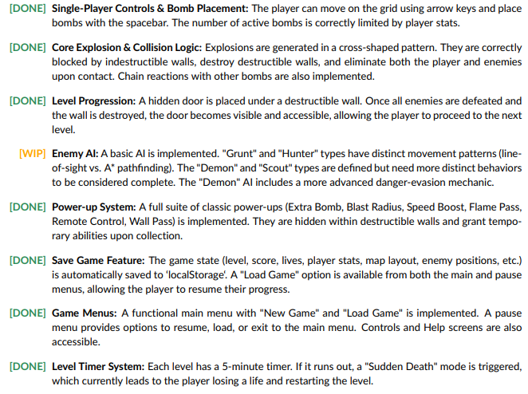
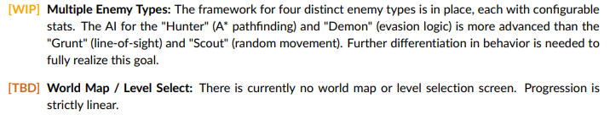

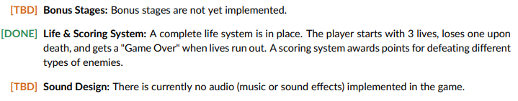
Current Progress
Essential Requirements
Desirable Requirements

Slide 8
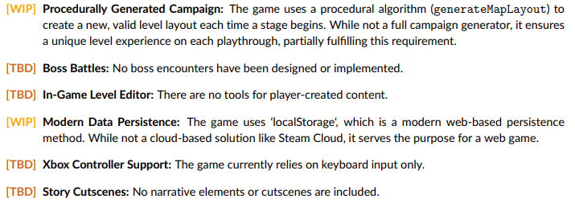
Current Progress
Optional Requirements

Slide 9
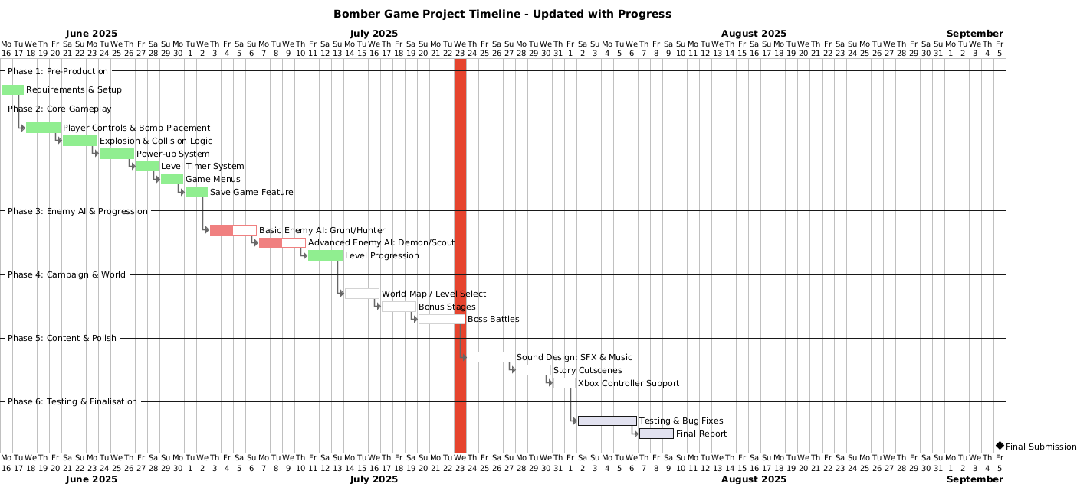
Gantt Chart

Slide 10
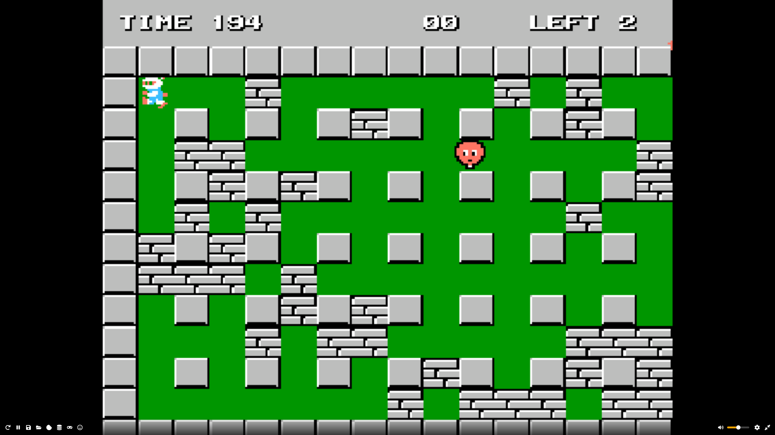
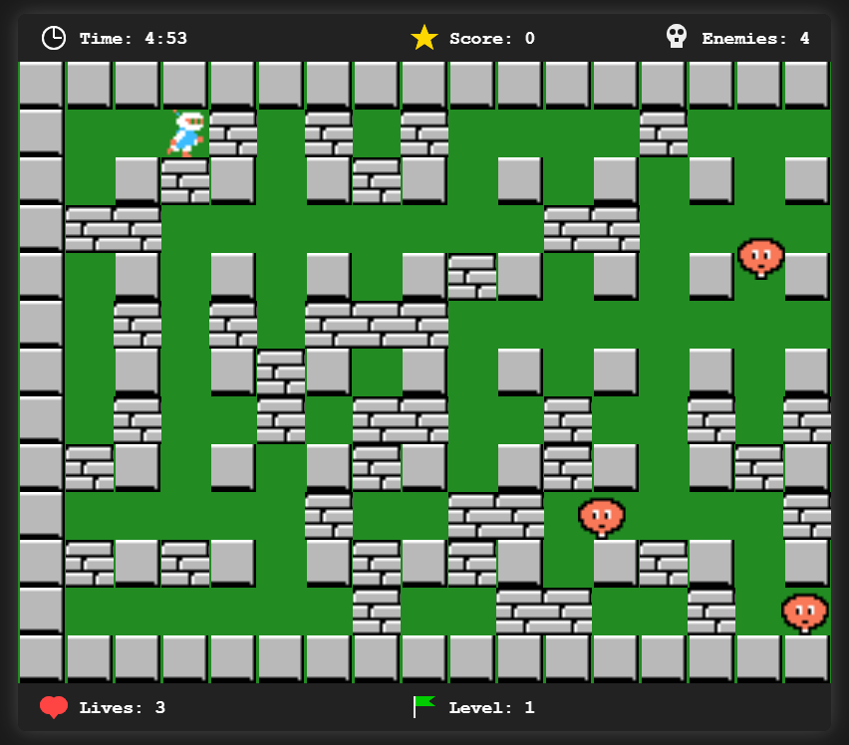
Bomberman (Original vs Clone)
Original
Clone

Slide 11
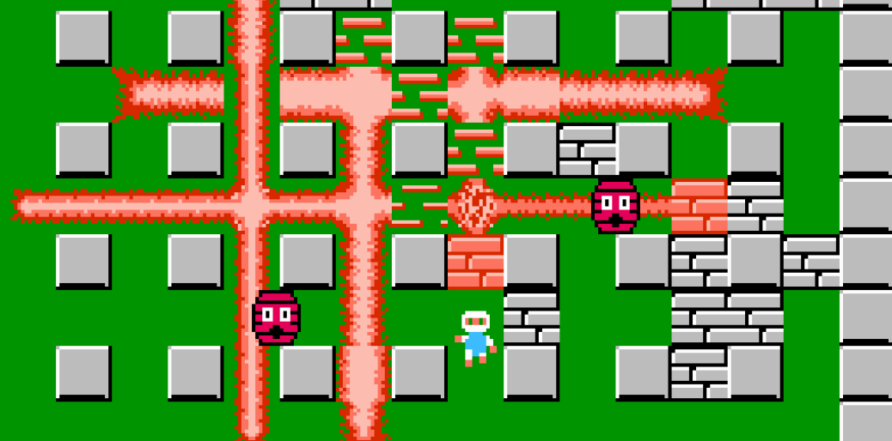
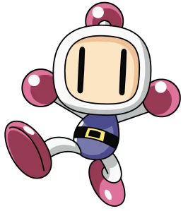
Thank you
Aaren Sherwin
ASSR1

